Slide 1

Automotive Technology: A Systems Approach, 8e
Chapter 54: Heating and Air Conditioning
Rob Thompson and Jack Erjavec, Automotive Technology: A Systems Approach, 8th Edition. © 2025 Cengage. All Rights Reserved. May not be scanned, copied or duplicated, or posted to a publicly accessible website, in whole or in part.

Slide 2
Chapter Objectives (1 of 2)
54.01 Identify the common parts of a heating and ventilation system.
54.02 Describe the operation of the various controls of a heating system.
54.03 Diagnose temperature control problems in the heater/ventilation/air conditioning system.
54.04 Describe how an automotive air-conditioning system operates.

Slide 3
Chapter Objectives (2 of 2)
54.05 Describe how refrigerants are used in the air-conditioning system.
54.06 Locate, identify, and describe the function of the various air-conditioning components.
54.07 Describe the operation of the types of air-conditioning control systems.

Slide 4
Ventilation System
Supplies fresh air to the passenger compartment
Air can be forced (ram air) while the vehicle is moving.
The ventilation fan circulates air within the passenger compartment when the vehicle is stopped.

Slide 5
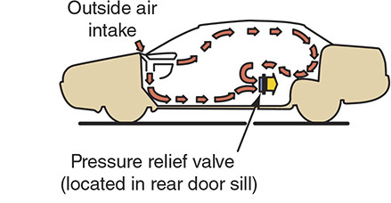
Flow-Through Ventilation System

Slide 6
Automotive Heating Systems
Works with the engine’s cooling system
Heat is used from the circulating coolant.
All vehicles must have passenger compartment heating and windshield defrosting.
On electric vehicles (EVs), waste heat from the battery pack, inverter, and drive motor(s) may be used to help heat the passenger compartment.

Slide 7
Heating System Components
54.01 Identify the common parts of a heating and ventilation system.
Heater core
Heater control valve or blend door
Blower motor and fan
Blower motor electrical controls
Heater and defroster ducts
Mode door controls

Slide 8
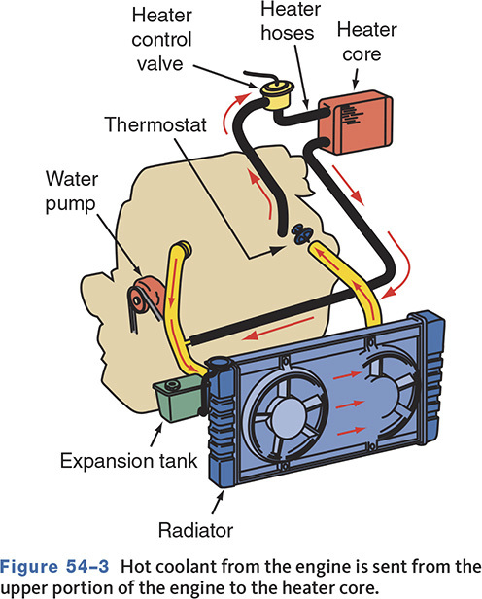
Coolant Flow-Through Heater

Slide 9
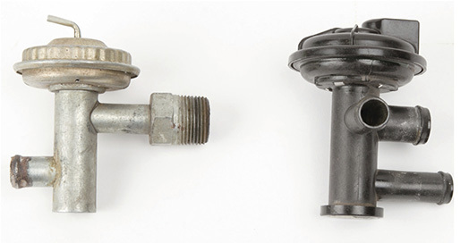
Heater Control Valve
54.02 Describe the operation of the various controls of a heating system.
Controls the flow of coolant to the heater core
May be cable, vacuum, or electronically operated

Slide 10
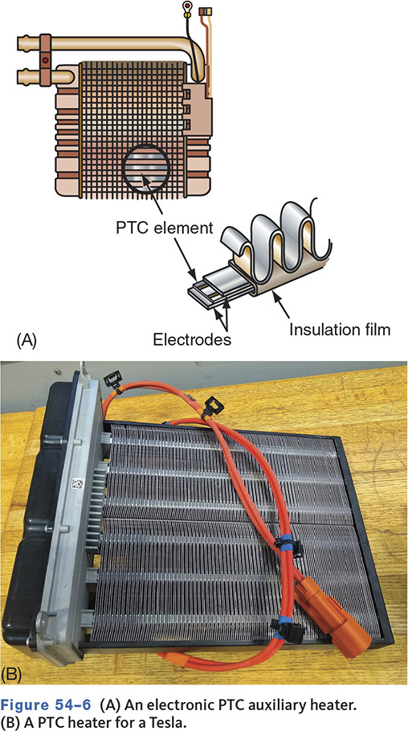
PTC Heaters
Reduces waste heat
Positive temperature coefficient heating element in the heater core

Slide 11
Blower Motor
Located in heater/evaporator housing
May be controlled by a resistor block and blower switch
Many systems use pulse width modulation for blower control.

Slide 12
Heater and Defroster Duct Hoses
The heater/evaporator case directs air to various vents
Most systems provide for fresh or recirculated air
Late-model vehicles may detect inlet air quality and change airflow depending on pollution levels
On automatic HVAC systems, when maximum cooling is requested, the control module switches to recirculated airflow.

Slide 13
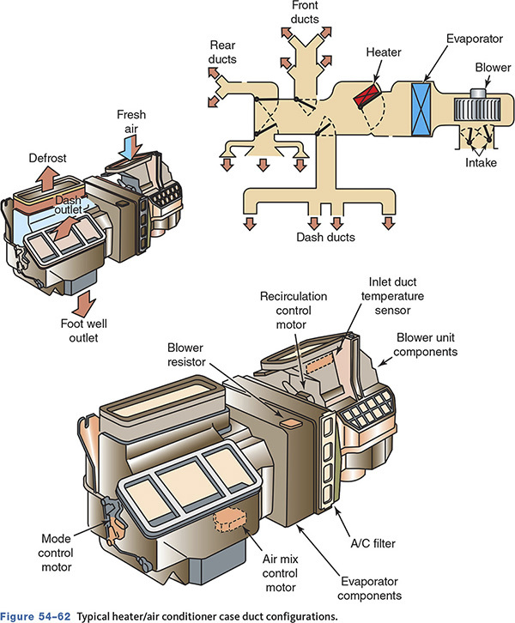
Typical HVAC Components

Slide 14
Heaters in Hybrid Vehicles
Some have additional heating elements for when the engine is off.
May use an auxiliary water pump for idle stop operation
Some vehicles use coolant storage tanks to reduce start-up emissions.

Slide 15
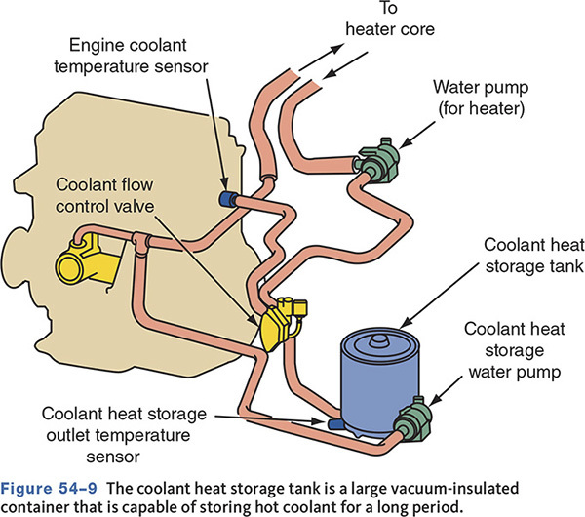
Typical Hybrid Heater System

Slide 16
Heater System Service
54-03 Diagnose temperature control problems in the heater/ventilation/air conditioning system.
Many times heating system problems are also cooling system problems.
  On ICE vehicles
Inspect coolant level and condition
Check temperature of heater inlet and outlet hoses
Check heater control valve for sticking open/closed and the valve’s controls

Slide 17
Basic Heater Inspection and Checks
Begin with a visual inspection and by checking coolant level and condition.
Run engine to normal operating temperature.
Measure temperature at radiator and heater hoses.
Inspect for leaks.

Slide 18
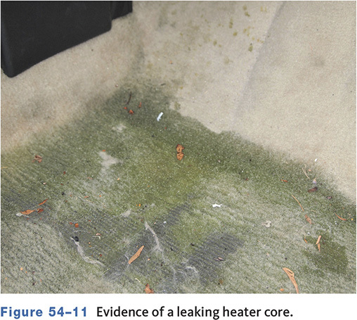
Evidence of a Leaking Heater Core

Slide 19
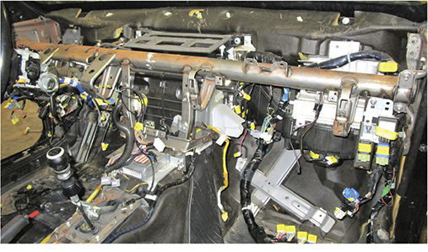
Heater Core Service
Needs to be repaired or replaced if plugged or leaking
Normally buried inside the heater/evaporator case

Slide 20
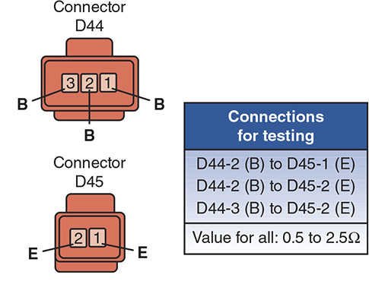
PTC Heaters
Can be checked by measuring the resistance of the heating element.

Slide 21
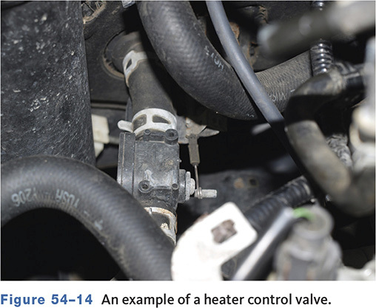
Heater Control Valve Service
Problem may be with the valve or the valve control.
Defective valves should be replaced.
Cable-operated valves may require adjustment.

Slide 22
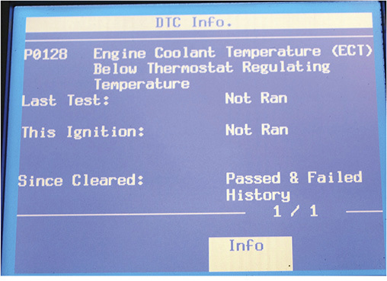
Trouble Codes
Late-model vehicles can set a DTC if the thermostat does not allow the engine to reach normal operating temperature.

Slide 23
Thermostat Service
A defective thermostat can cause a lack of heat.
The engine may not reach operating temperature.
A stuck closed thermostat can cause the engine to overheat.
Some engines use electrically assisted thermostats.

Slide 24
Blower Motor Service
Use a DMM to make sure there is voltage on both sides of the fuse
Check power and ground circuits
If it only works in certain speeds, check blower resistor and control circuits

Slide 25
Table 54-1 Blower Motor Diagnosis
Problem | Possible Cause
Blower inoperative all speeds | Open fuse, defective relay, faulty blower motor, open ground circuit, faulty switch
Works on high speed only | Open fuse, defective relay, open blower resistor
High speed inoperative | Open high-speed fuse, defective high-speed relay, faulty blower switvh, open in high-speed circuit
Inoperative on various speeds | Open in blower resistor, faulty lower switch
Rob Thompson and Jack Erjavec, Automotive Technology: A Systems Approach, 8th Edition. © 2025 Cengage. All Rights Reserved. May not be scanned, copied or duplicated, or posted to a publicly accessible website, in whole or in part.

Slide 26
Heater and Defroster Duct Service
If the blower runs but no air comes out, inspect airflow control or blend door.
Most current HVAC systems use electric servomotors to move the various doors.
Motor uses a potentiometer to relay actual door position.
Some newer systems use phase detecting servo motors.

Slide 27
Knowledge Check (1 of 3)
Technician A says a stuck closed thermostat can cause the engine to overheat.
Technician B says a stuck open thermostat can cause the engine to overheat.
Who is correct?

Slide 28
Knowledge Check Answer (1 of 3)
Technician A says a stuck closed thermostat can cause the engine to overheat.
Technician B says a stuck open thermostat can cause the engine to overheat.
Who is correct?
Answer: A Only

Slide 29
Heat Flow
All substances contain heat.
Heat always flows from a warmer object to a colder one.
The greater the temperature difference, the greater the rate of heat flow.

Slide 30
Heat Absorption
  Objects can be in three forms—solid, liquid, or gas.
  When objects change state, large amounts of heat can be transferred.
  The amount of heat necessary to change the state of a substance is called latent heat.

Slide 31
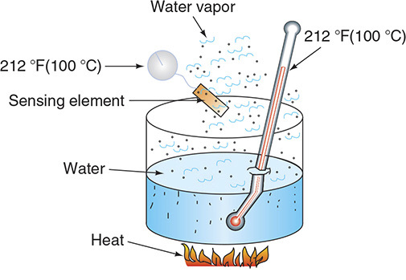
Latent Heat

Slide 32
Pressure and Boiling Points (1 of 2)
Changing pressure on a substance changes its boiling point.
The greater the pressure, the higher the boiling point.
If pressure is raised on a vapor, the vapor condenses at a higher temperature.

Slide 33
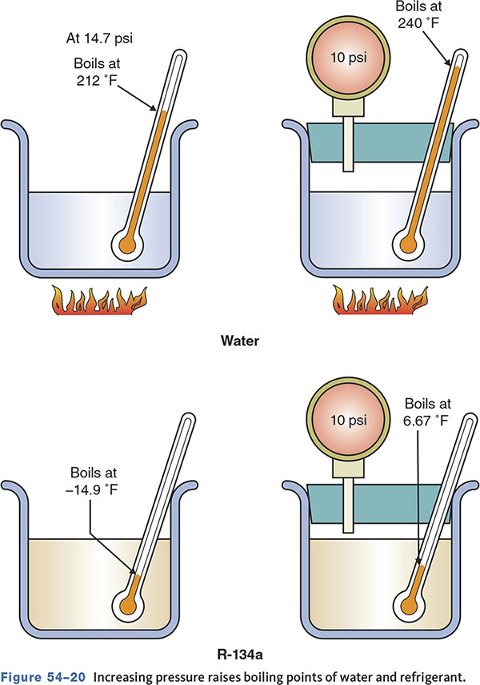
Pressure and Boiling Points (2 of 2)

Slide 34
Relative Humidity
The amount of moisture the air can hold is directly related to the air temperature.
The warmer the air, the more moisture it can hold.
Lowering the temperature reduces humidity.

Slide 35
Refrigerants
54.05 Describe how refrigerants are used in the air-conditioning system.
Designed to move heat from one point to another
R-12 was used until 1995.
R-12 is dichlorodifluoromethane.
No longer used due to chlorofluorocarbon’s (CFC) effects on the ozone layer
Was replaced with R-134a

Slide 36
R-134a
A hydrofluorocarbon (HFC)
  Less damaging to the ozone layer
  Not interchangeable with R-12
R-134a operates at higher pressures.
European and Japanese manufacturers began to phase out R-134a in 2013.

Slide 37
HFO-1234yf
Replacement for R-134a
Operating pressures and temperatures are similar to R-134a.
Has a global warming potential (GWP) of 4 compared to 1430 for R-134a
Some manufacturers held implementation due to flammability concerns.
Will require all new gauges and service tools

Slide 38
Alternative Refrigerants
The EPA publishes a list of approved alternatives.
Flammable substances are illegal.
CO₂ as a refrigerant is labeled R744.
  Has a very low global warming potential (GWP)
  Can be up to 25 percent more efficient
  Operates at high pressures

Slide 39
CO₂ Systems
It is claimed that CO₂-based systems will be up to 25 percent more energy efficient than the best of today’s systems.
Can be used in heat pump systems
The operation of a CO₂ system is the same as that of any other A/C system, but the components are different due to the higher pressures.
May require sensors to monitor cabin air quality

Slide 40
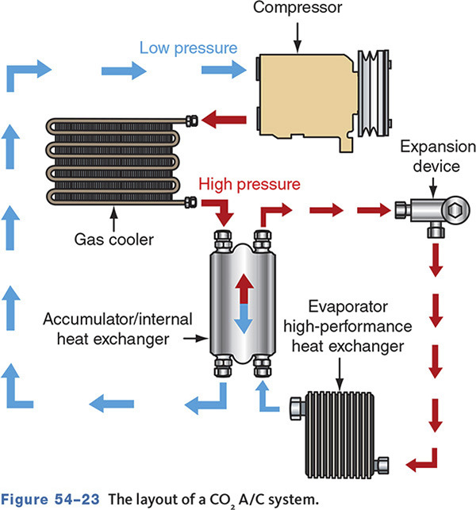
CO₂ System Layout

Slide 41
Basic A/C System Operation
54-04 Describe how an automotive air-conditioning system operates.
As the refrigerant changes state, it absorbs heat.
If the refrigerant pressure is high, so is its temperature.
To absorb heat, the temperature and pressure are kept low.
To dissipate heat, temperature and pressure are high.

Slide 42
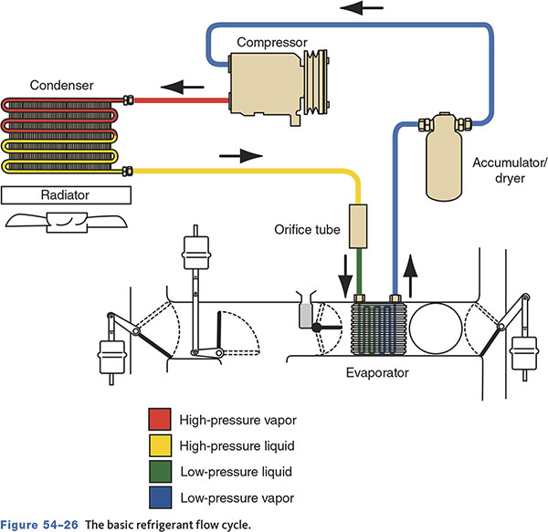
Basic Refrigerant Cycle

Slide 43
Knowledge Check (2 of 3)
True or False:
When the refrigerant temperature and pressure are low, it is able to absorb heat.

Slide 44
Knowledge Check Answer (2 of 3)
True or False:
When the refrigerant temperature and pressure are low, it is able to absorb heat.
Answer: True

Slide 45
System Components
54.06 Locate, identify, and describe the function of the various air-conditioning components.
Compressor
    Separates the high and low sides of the system
    Pumps refrigerant vapor
    Draws low-pressure low-temperature vapor from the evaporator
    Compresses vapor into high-temperature high-pressure vapor
    Circulates the vapor to the condenser

Slide 46
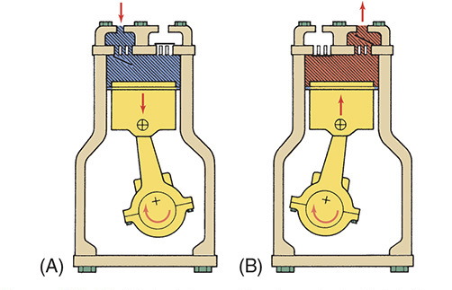
Compressor Strokes

Slide 47
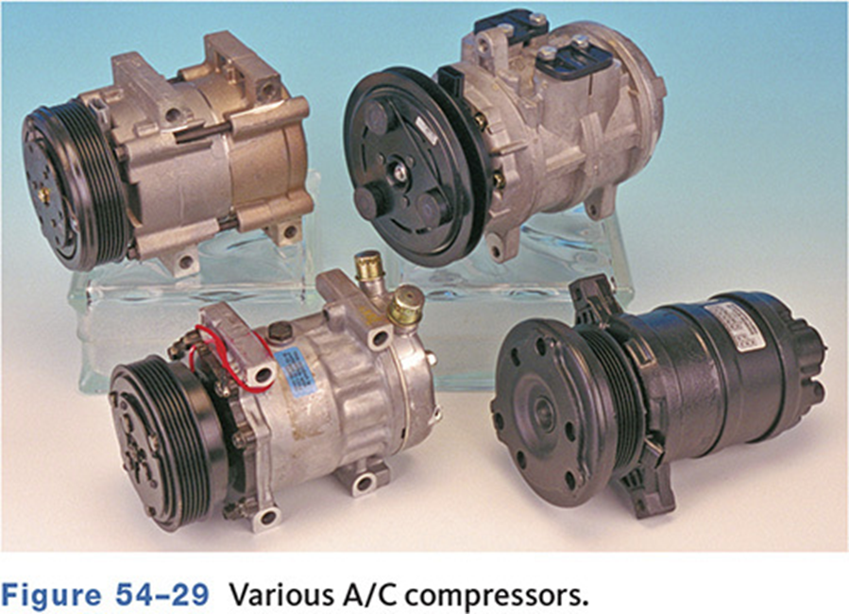
Compressor Designs
Piston-type
Variable displacement-type
Rotary vane-type
Scroll-type

Slide 48
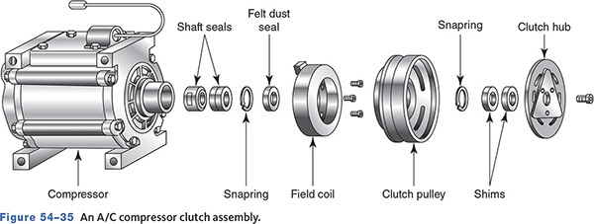
Compressor Clutches
Engages the compressor pulley to the compressor drive shaft

Slide 49
Electric Drive Compressors
Used for vehicles equipped with idle stop or start-stop system
Compressor contains an electric motor drive.
Can run without the engine running
More energy efficient than belt driven type
Requires special refrigerant oil

Slide 50
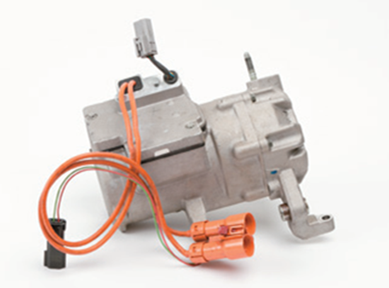
Electric A/C Compressor

Slide 51
Refrigerant Oils
Is carried through the system with the refrigerant
R-12 systems used mineral oil.
R-134a systems require polyalkaline glycol (PAG) or polyester (POE) oils.
POE oils are commonly used in hybrid and EV compressors due to their low conductivity.

Slide 52
Condenser (1 of 2)
Transfers heat from the refrigerant to the outside air
Mounted in front of radiator
Condenses or liquefies the high-pressure high-temperature vapor

Slide 53
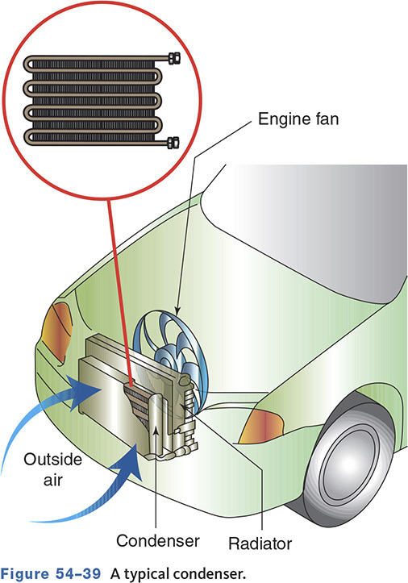
Condenser (2 of 2)

Slide 54
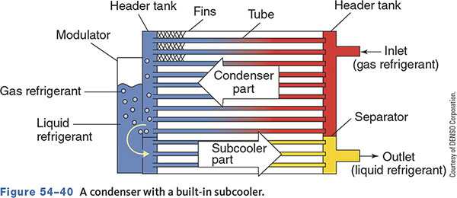
Subcoolers
Removes sensible heat from liquid refrigerant
Located between the condenser and evaporator
Increases system efficiency

Slide 55
Receiver/Dryer
Stores liquid refrigerant from condenser
Contains a desiccant to remove moisture
Connected on the high side of the system
Sometimes part of the condenser assembly

Slide 56
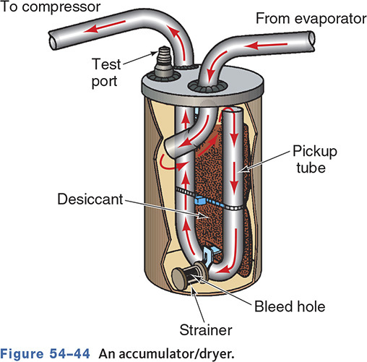
Accumulator
Used as a receiver/dryer on some systems
Connected on low side of system
Stores any liquid refrigerant that flows out of the evaporator

Slide 57
Thermostatic Expansion Valve (TXV) (1 of 2)
Controls the flow of refrigerant to the evaporator
The TEV is mounted at the evaporator inlet and separates the high side from the low side.
Regulates flow by balancing inlet flow and outlet temperature

Slide 58
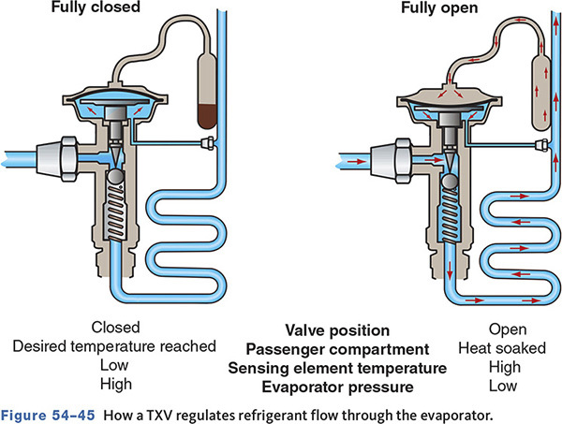
Thermostatic Expansion Valve (TXV) (2 of 2)

Slide 59
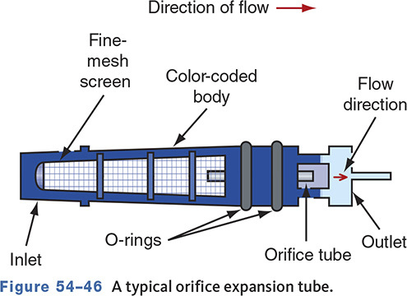
Orifice Tube
It is the dividing point between high and low pressure.
A fixed orifice controls flow rate based on the pressure difference across the orifice.

Slide 60
Evaporator
Receives atomized refrigerant spray
Acts as a boiler or vaporizer
As the refrigerant boils, it absorbs heat.
Moisture in the air condenses on the outside of the evaporator and is drained off.

Slide 61
Refrigerant Lines
Suction Lines
    Between evaporator outlet and compressor inlet
    Carry low-pressure/temperature vapor
    Cold to the touch and larger in diameter
Discharge Lines
    Connect compressor outlet to condenser
Liquid Lines
    Connect condenser to receiver/dryer

Slide 62
Knowledge Check (3 of 3)
Which component is responsible for separating the A/C system into the high- and low-pressure sides?
  Evaporator
  Orifice tube
  Compressor
  Condenser

Slide 63
Knowledge Check Answer (3 of 3)
Which component is responsible for separating the A/C system into the high- and low-pressure sides?
  Evaporator
  Orifice tube
  Compressor
  Condenser
  Answer: B. Orifice tube

Slide 64
A/C Systems and Controls
54.07 Describe the operation of the types of air-conditioning control systems.
Cycling Clutch Systems
    Compressor runs intermittently.
Evaporator Pressure/Temperature Control Systems
    Compressor operates continuously when A/C controls are in the on position.

Slide 65
Examples of Compressor Controls
Ambient temperature switch
Thermostatic switch
Pressure cycling switch
Low-pressure cut-off switch
High-pressure cut-out switch
High-pressure relief valve
Compressor control valve
Electronic cycling clutch switch

Slide 66
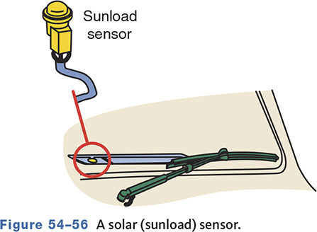
Solar Sensor
Also called a sun load sensor
Used to anticipate the heat from sunlight

Slide 67
Temperature Control Systems
Systems may be manually or automatically controlled.
Manual controls require changes to fan speed, discharge temperature, and vent selection.
Automatic systems monitor interior temperature and adjust as needed.

Slide 68
Manual/Semiautomatic Controls
Operate similar to heater controls
Control head settings control blend door and air direction
Cooling controlled by control settings and blower speeds

Slide 69
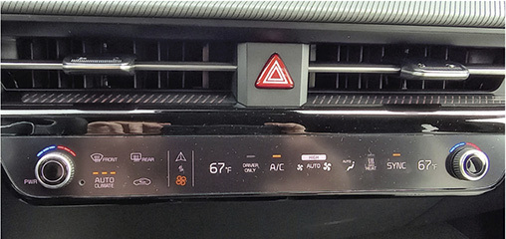
Automatic Climate Control
Maintains specific temperature
Uses heat sensors
A control module uses sensor and driver input to control the compressor and blend functions.

Slide 70
Typical Heater/Air Conditioner

Slide 71
Dual Zone Systems
Both driver and passenger sides have separate climate controls.
Some systems are tied into the navigation system.
  The A/C system calculates vehicle direction, time, location, sun load, and other information to determine the ideal heating or cooling for each side.

Slide 72
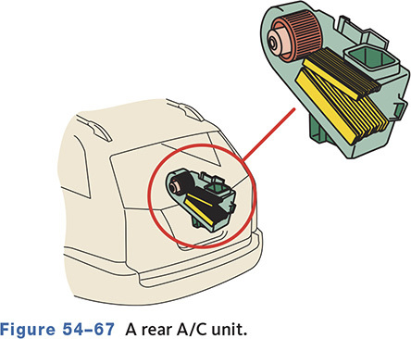
Rear Systems
Rear A/C systems use a separate rear A/C unit.
The compressor moves refrigerant for both the front and rear systems.
Has separate controls for front and rear

Slide 73
Chapter Reflection
Write down a concept from this chapter that challenged you.
  Describe what made the concept difficult for you.
  What steps did you take improve your understanding?
  How could you help another student who was struggling with the same concept?
Use 100–150 words in your answer.

